Slide 1


Toward Building an Automated Fact-checking System
Damian Jimenez
Department of Computer Science and Engineering
University of Texas at Arlington

Slide 2
Society’s Struggle with Falsehoods
Politicians make false, and misleading claims all the time.
Fake-news floods the Internet; exacerbated by social media (“filter bubbles” and “echo chambers”).
Facebook trend topic algorithms promoted fake-news.
A sample of 140,000 Twitter users in the battleground state of Michigan shared as many junk news items as professional news during the final ten days of the 2016 election. http://politicalbots.org/?p=1064
National security threats:
U.S. intelligence community concluded that the Russian government interfered with the 2016 election. Fake-news websites and bots used.
“Pizzagate”

Slide 3
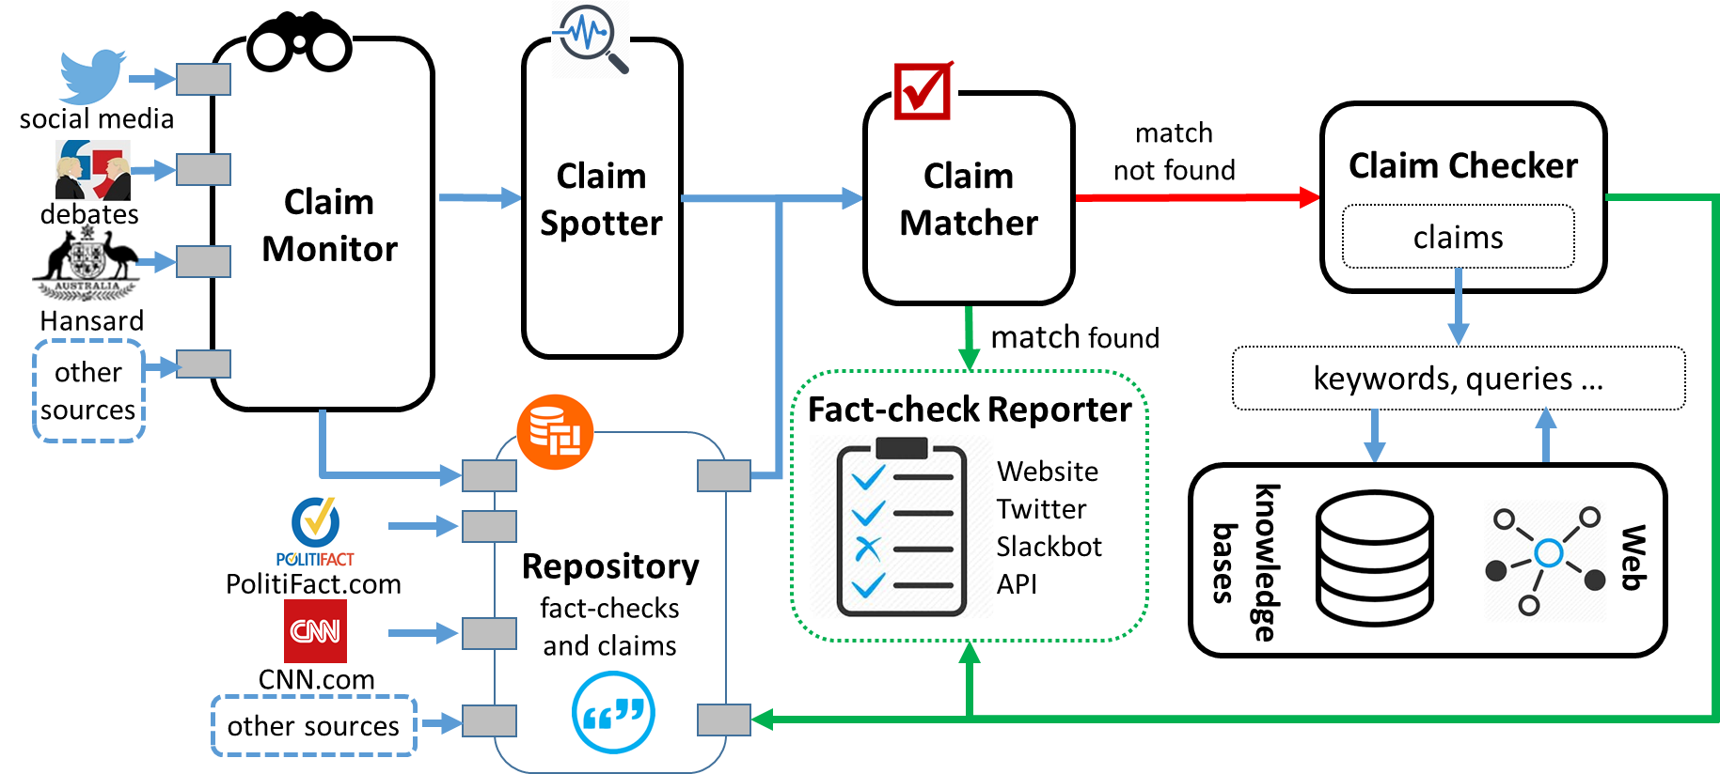
The First-ever End-to-end System

Slide 4
idir.uta.edu/claimbuster

Slide 5
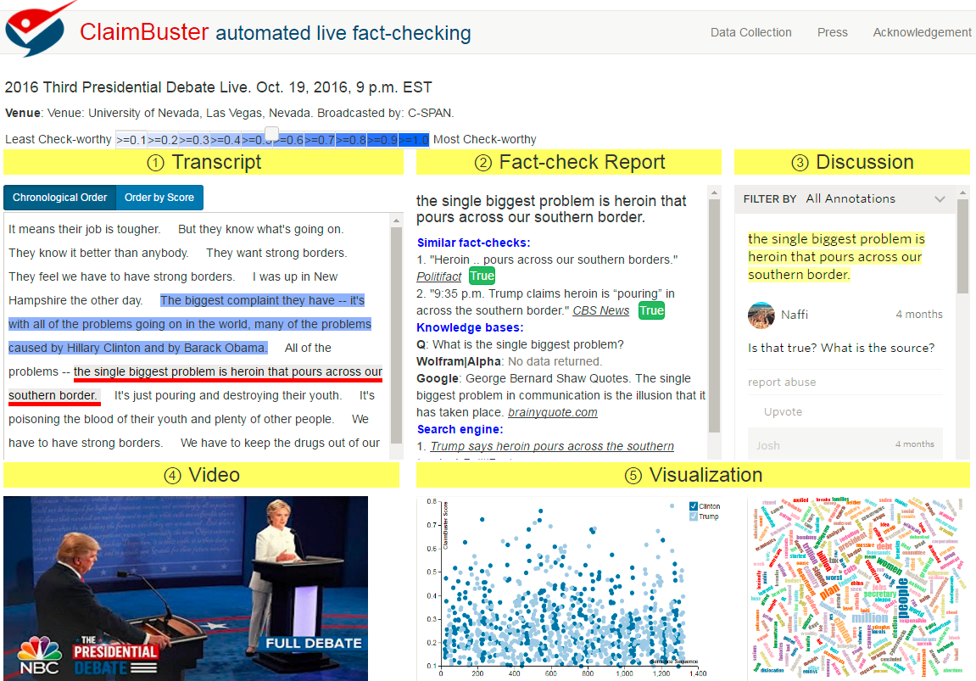

Slide 7
Evaluating Limitations of Current Question Generation Tools and Question Answering Engines
~300 claims/questions from each source:
Claims
Tweets with factual claims
PolitiFact fact-checks
“Elias Says” sports statistics
Wikipedia opening-paragraph sentences
Questions
Wikipedia QA dataset
Trivia questions

Slide 8
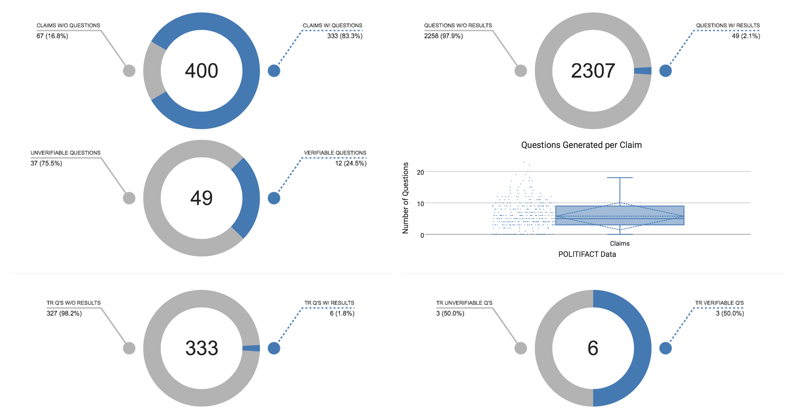
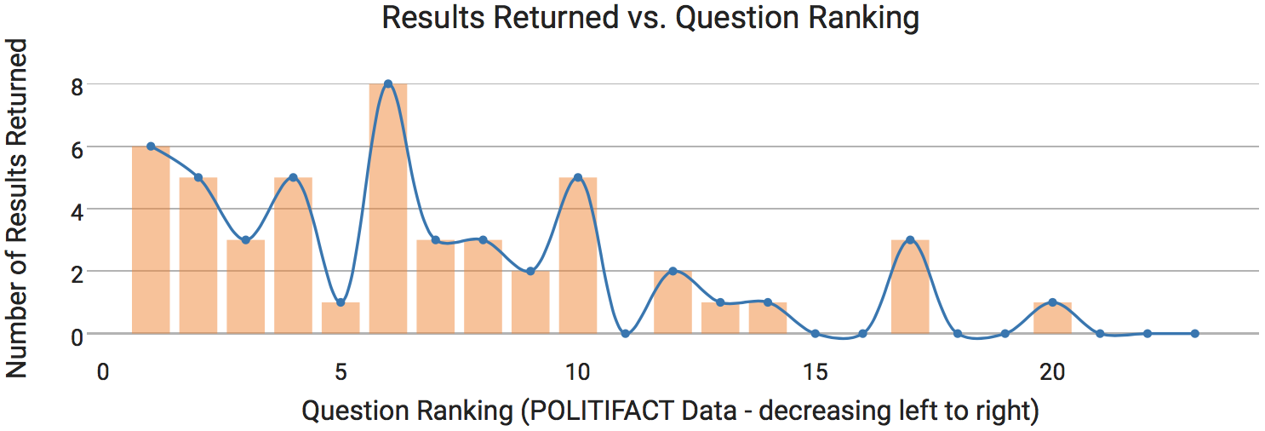
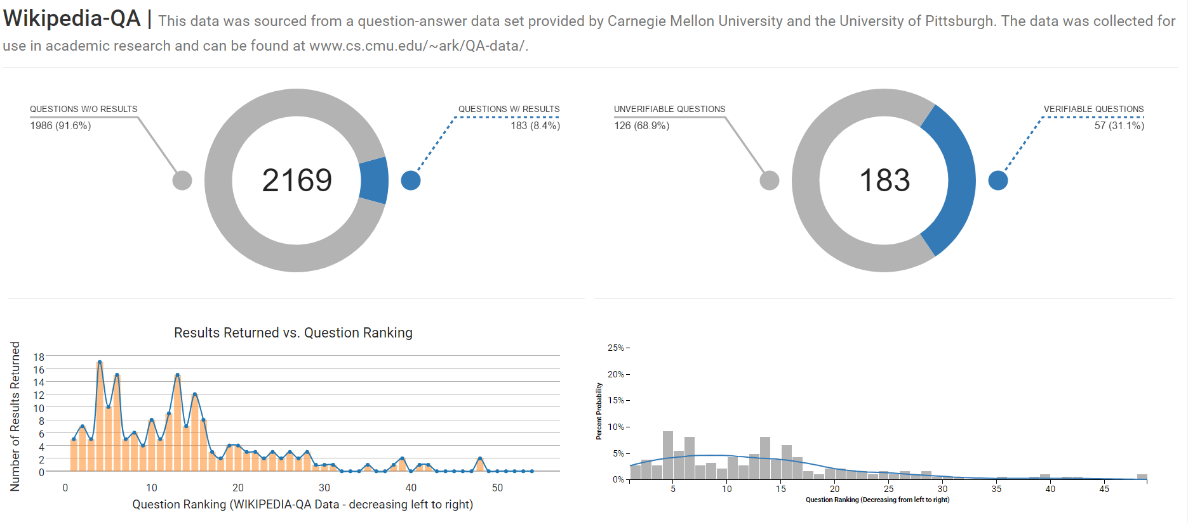
TR: Top Rated
Q’S: Questions
PolitiFact Dataset
http://qgqa-cached.herokuapp.com
qgqa-cached.herokuapp.com

Slide 9

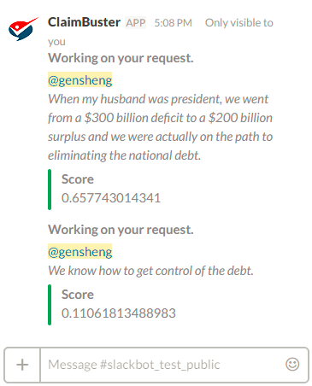
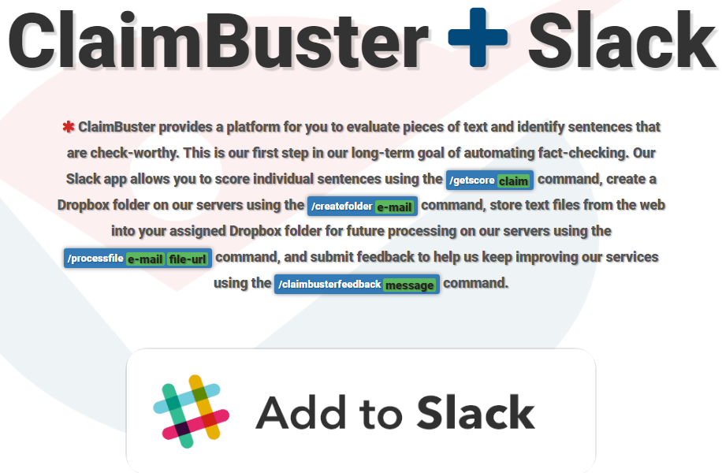

Slide 11



Acknowledgment
Funding sponsors
Disclaimer: This material is based upon work partially supported by the National Science Foundation Grants 1408928 and 1565699 and a Knight Prototype Fund from the Knight Foundation. Any opinions, findings, and conclusions or recommendations expressed in this material are those of the author(s) and do not necessarily reflect the views of the funding agencies.

Slide 12
Thank You! Questions?
http://idir.uta.edu/claimbuster

